Slide 1
Basic Structures: Sets, Functions, Sequences, Sums, and Matrices
Chapter 2

Slide 2
Chapter Summary
Sets
The Language of Sets
Set Operations
Set Identities
Functions
Types of Functions
Operations on Functions
Sequences and Summations
Types of Sequences
Summation Formulae
Matrices
Matrix Arithmetic

Slide 3
Sets
Section 2.1

Slide 4
Section Summary
Definition of sets
Describing Sets
Roster Method
Set-Builder Notation
Some Important Sets in Mathematics
Empty Set and Universal Set
Subsets and Set Equality
Cardinality of Sets
Tuples
Cartesian Product

Slide 5
Introduction
Sets are one of the basic building blocks for the types of objects considered in discrete mathematics.
Important for counting.
Programming languages have set operations.
Set theory is an important branch of mathematics.
Many different systems of axioms have been used to develop set theory.
Here we are not concerned with a formal set of axioms for set theory. Instead, we will use what is called naïve set theory.

Slide 6
Sets
A set is an unordered collection of objects.
the students in this class
the chairs in this room
The objects in a set are called the elements, or members of the set. A set is said to contain its elements.
The notation a ∈ A denotes that a is an element of the set A.
If a is not a member of A, write a ∉ A

Slide 7
Describing a Set: Roster Method
S = {a,b,c,d}
Order not important
S = {a,b,c,d} = {b,c,a,d}
Each distinct object is either a member or not; listing more than once does not change the set.
S = {a,b,c,d} = {a,b,c,b,c,d}
Elipses (…) may be used to describe a set without listing all of the members when the pattern is clear.
S = {a,b,c,d, ……,z }

Slide 8
Roster Method
Set of all vowels in the English alphabet:
V = {a,e,i,o,u}
Set of all odd positive integers less than 10:
O = {1,3,5,7,9}
Set of all positive integers less than 100:
S = {1,2,3,……..,99}
Set of all integers less than 0:
S = {…., -3,-2,-1}

Slide 9
Some Important Sets
N = natural numbers = {0,1,2,3….}
Z = integers = {…,-3,-2,-1,0,1,2,3,…}
Z⁺ = positive integers = {1,2,3,…..}
R = set of real numbers
R⁺ = set of positive real numbers
C = set of complex numbers.
Q = set of rational numbers

Slide 10
Set-Builder Notation
Specify the property or properties that all members must satisfy:
S = {x | x is a positive integer less than 100}
O = {x | x is an odd positive integer less than 10}
O = {x ∈ Z⁺ | x is odd and x < 10}
A predicate may be used:
S = {x | P(x)}
Example: S = {x | Prime(x)}
Positive rational numbers:
Q⁺ = {x ∈ R | x = p/q, for some positive integers p,q}

Slide 11
Interval Notation
[a,b] = {x | a ≤ x ≤ b}
[a,b) = {x | a ≤ x < b}
(a,b] = {x | a < x ≤ b}
(a,b) = {x | a < x < b}
closed interval [a,b]
open interval (a,b)

Slide 12
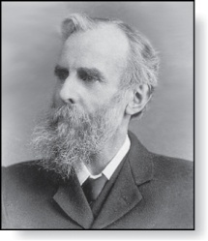
Universal Set and Empty Set
The universal set U is the set containing everything currently under consideration.
Sometimes implicit
Sometimes explicitly stated.
Contents depend on the context.
The empty set is the set with no
elements. Symbolized ∅, but
{} also used.
Venn Diagram
U
V
a e i
o u
John Venn (1834-1923)
Cambridge, UK

Slide 13
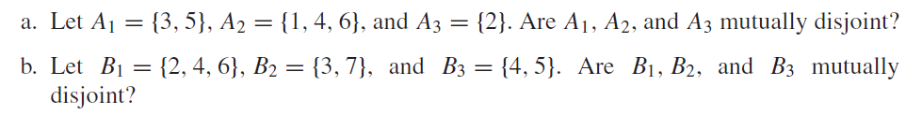
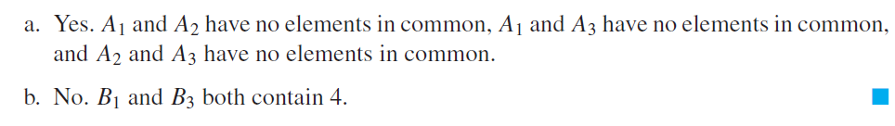
Example

Slide 14
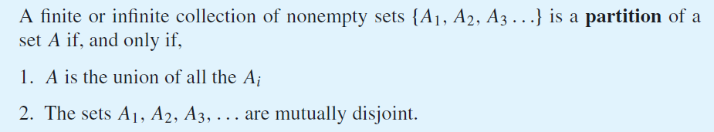
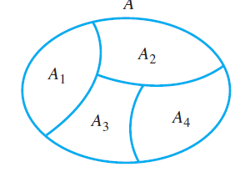
Partition of a Set

Slide 15
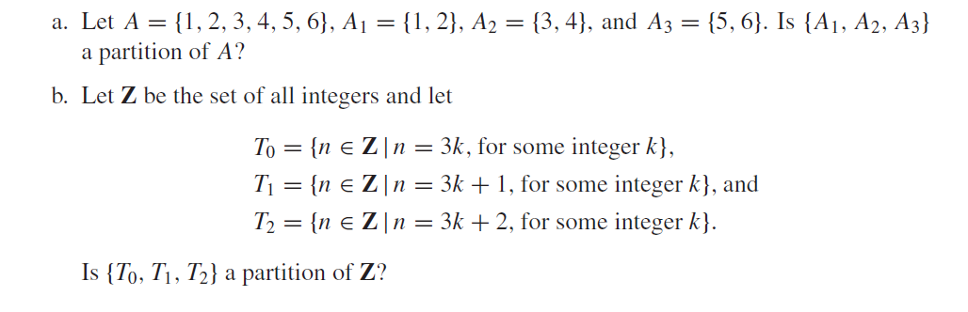
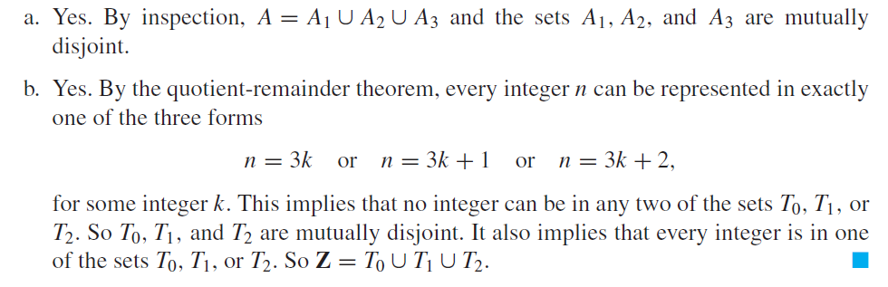
Example

Slide 16
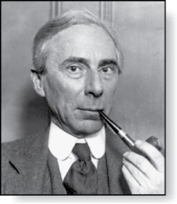
Russell’s Paradox
Let S be the set of all sets which are not members of themselves. A paradox results from trying to answer the question “Is S a member of itself?”
Related Paradox:
Henry is a barber who shaves all people who do not shave themselves. A paradox results from trying to answer the question “Does Henry shave himself?”
Bertrand Russell (1872-1970)
Cambridge, UK
Nobel Prize Winner

Slide 17
Some things to remember
Sets can be elements of sets.
{{1,2,3},a, {b,c}}
{N,Z,Q,R}
The empty set is different from a set containing the empty set.
∅ ≠ { ∅ }

Slide 18
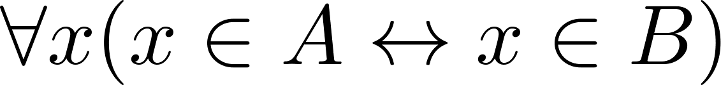
Set Equality
Definition: Two sets are equal if and only if they have the same elements.
Therefore if A and B are sets, then A and B are equal if and only if .
We write A = B if A and B are equal sets.
{1,3,5} = {3, 5, 1}
{1,5,5,5,3,3,1} = {1,3,5}

Slide 19
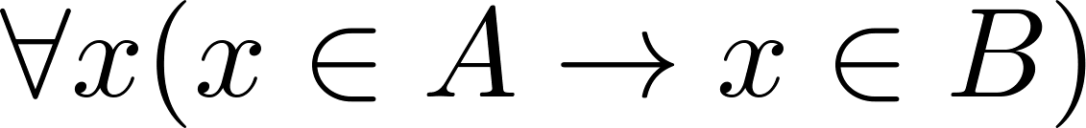
Subsets
Definition: The set A is a subset of B, if and only if every element of A is also an element of B.
The notation A ⊆ B is used to indicate that A is a subset of the set B.
A ⊆ B holds if and only if is true.
Because a ∈ ∅ is always false, ∅ ⊆ S ,for every set S.
Because a ∈ S → a ∈ S, S ⊆ S, for every set S.

Slide 20
Showing a Set is or is not a Subset of Another Set
Showing that A is a Subset of B: To show that A ⊆ B, show that if x belongs to A, then x also belongs to B.
Showing that A is not a Subset of B: To show that A is not a subset of B, A ⊈ B, find an element x ∈ A with x ∉ B. (Such an x is a counterexample to the claim that x ∈ A implies x ∈ B.)
Examples:
The set of all computer science majors at your school is a subset of all students at your school.
The set of integers with squares less than 100 is not a subset of the set of nonnegative integers.

Slide 21
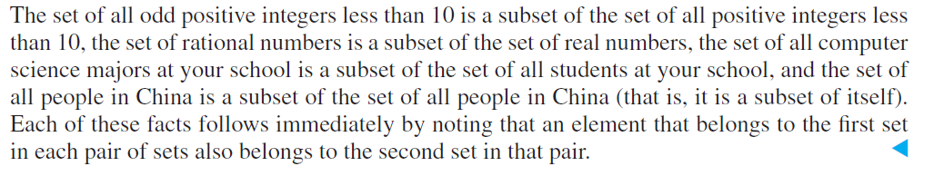
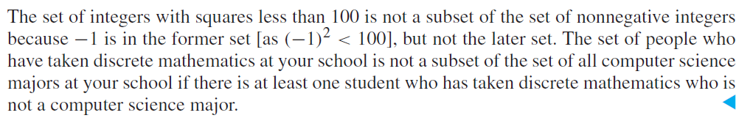
Example

Slide 22
Another look at Equality of Sets
Recall that two sets A and B are equal, denoted by A = B, iff
Using logical equivalences we have that A = B iff
This is equivalent to
A ⊆ B and B ⊆ A

Slide 23
Proper Subsets
Definition: If A ⊆ B, but A ≠B, then we say A is a proper subset of B, denoted by A ⊂ B. If A ⊂ B, then
is true.
Venn Diagram
U
B
A

Slide 24
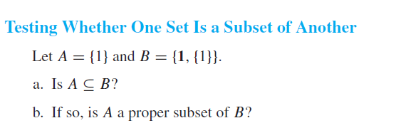
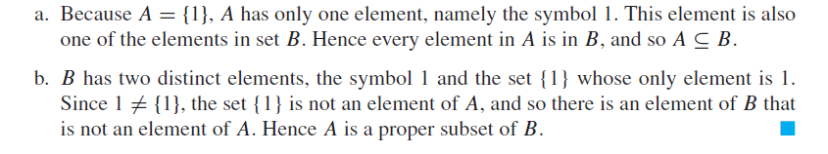
Example

Slide 25
Set Cardinality
Definition: If there are exactly n distinct elements in S where n is a nonnegative integer, we say that S is finite. Otherwise it is infinite.
Definition: The cardinality of a finite set A, denoted by |A|, is the number of (distinct) elements of A.
Examples:
|ø| = 0
Let S be the letters of the English alphabet. Then |S| = 26
|{1,2,3}| = 3
|{ø}| = 1
The set of integers is infinite.

Slide 26
Power Sets
Definition: The set of all subsets of a set A, denoted P(A), is called the power set of A.
Example: If A = {a,b} then
P(A) = {ø, {a},{b},{a,b}}
If a set has n elements, then the cardinality of the power set is 2ⁿ. (In Chapters 5 and 6, we will discuss different ways to show this.)

Slide 27
Tuples
The ordered n-tuple (a₁,a₂,…..,a_{n}) is the ordered collection that has a₁ as its first element and a₂ as its second element and so on until a_{n} as its last element.
Two n-tuples are equal if and only if their corresponding elements are equal.
2-tuples are called ordered pairs.
The ordered pairs (a,b) and (c,d) are equal if and only if a = c and b = d.

Slide 28
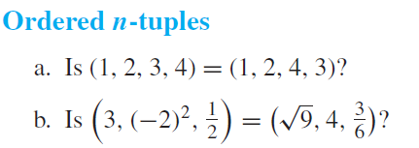
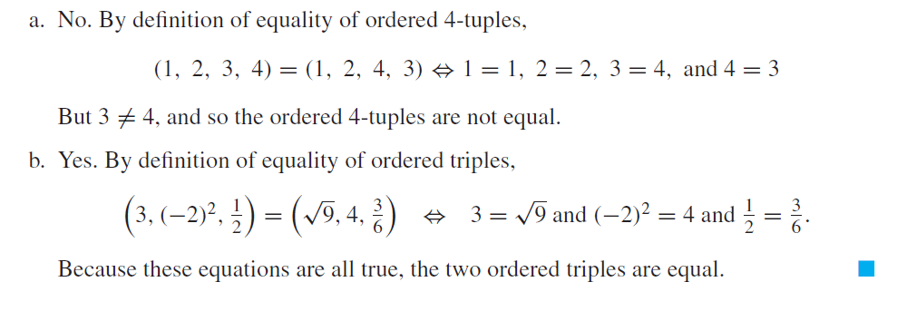
Example

Slide 29
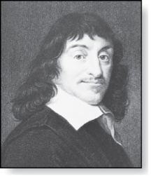
Cartesian Product
René Descartes (1596-1650)
Definition: The Cartesian Product of two sets A and B, denoted by A × B is the set of ordered pairs (a,b) where a ∈ A and b ∈ B .
Example:
A = {a,b} B = {1,2,3}
A × B = {(a,1),(a,2),(a,3), (b,1),(b,2),(b,3)}
Definition: A subset R of the Cartesian product A × B is called a relation from the set A to the set B. (Relations will be covered in depth in Chapter 9. )

Slide 30
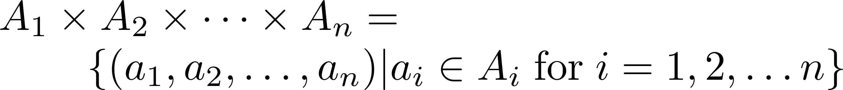
Cartesian Product
Definition: The cartesian products of the sets A₁,A₂,……,A_{n}, denoted by A₁ × A₂ × …… × A_{n} , is the set of ordered n-tuples (a₁,a₂,……,a_{n}) where a_{i} belongs to A_{i} for i = 1, … n.
Example: What is A × B × C where A = {0,1}, B = {1,2} and C = {0,1,2}
Solution: A × B × C = {(0,1,0), (0,1,1), (0,1,2),(0,2,0), (0,2,1), (0,2,2),(1,1,0), (1,1,1), (1,1,2), (1,2,0), (1,2,1), (1,1,2)}

Slide 31
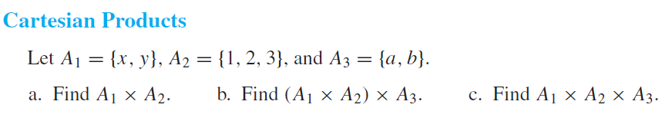
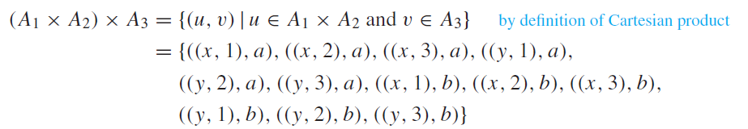
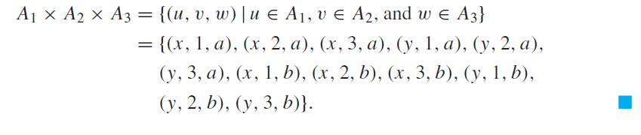
Example

Slide 32
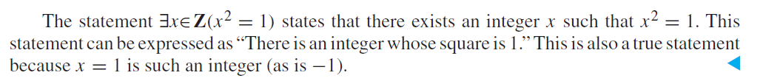
Using Set Notation with Quantifiers

Slide 33
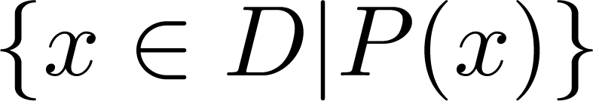
Truth Sets of Quantifiers
Given a predicate P and a domain D, we define the truth set of P to be the set of elements in D for which P(x) is true. The truth set of P(x) is denoted by
Example: The truth set of P(x) where the domain is the integers and P(x) is “|x| = 1” is the set {-1,1}

Slide 34
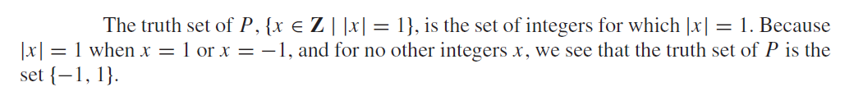
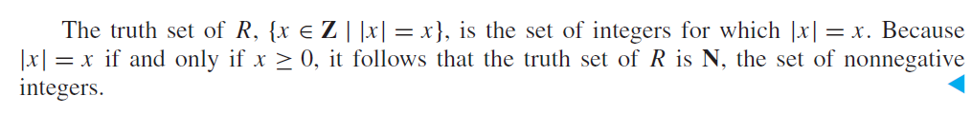
Example

Slide 35
Set Operations
Section 2.2

Slide 36
Section Summary
Set Operations
Union
Intersection
Complementation
Difference
More on Set Cardinality
Set Identities
Proving Identities
Membership Tables

Slide 37
Boolean Algebra
Propositional calculus and set theory are both instances of an algebraic system called a Boolean Algebra.
The operators in set theory are analogous to the corresponding operator in propositional calculus.
As always there must be a universal set U. All sets are assumed to be subsets of U.

Slide 38
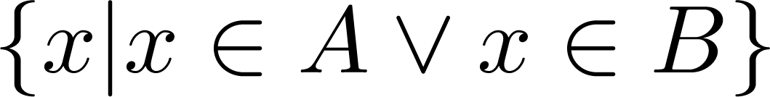
Union
Definition: Let A and B be sets. The union of the sets A and B, denoted by A ∪ B, is the set:
Example: What is {1,2,3} ∪ {3, 4, 5}?
Solution: {1,2,3,4,5}
Venn Diagram for A ∪ B
U
A
B

Slide 39
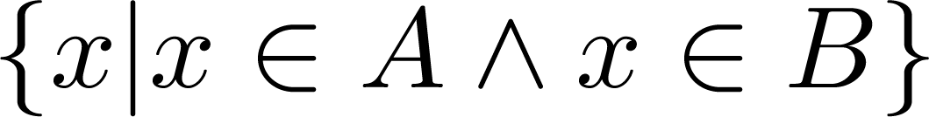
Intersection
Definition: The intersection of sets A and B, denoted by A ∩ B, is
Note if the intersection is empty, then A and B are said to be disjoint.
Example: What is? {1,2,3} ∩ {3,4,5} ?
Solution: {3}
Example:What is?
{1,2,3} ∩ {4,5,6} ?
Solution: ∅
Venn Diagram for A ∩B
U
A
B

Slide 40
Complement
Definition: If A is a set, then the complement of the A (with respect to U), denoted by Ā is the set U - A
Ā = {x ∈ U | x ∉ A}
(The complement of A is sometimes denoted by A^{c} .)
Example: If U is the positive integers less than 100, what is the complement of {x | x > 70}
Solution: {x | x ≤ 70}
Venn Diagram for Complement
U
Ā
A

Slide 41
Difference
Definition: Let A and B be sets. The difference of A and B, denoted by A – B, is the set containing the elements of A that are not in B. The difference of A and B is also called the complement of B with respect to A.
A – B = {x | x ∈ A ∧ x ∉ B} = A ∩‾B
U
Venn Diagram for A − B
A
B

Slide 42
The Cardinality of the Union of Two Sets
Inclusion-Exclusion
|A ∪ B| = |A| + | B| - |A ∩ B|
Example: Let A be the math majors in your class and B be the CS majors. To count the number of students who are either math majors or CS majors, add the number of math majors and the number of CS majors, and subtract the number of joint CS/math majors.
We will return to this principle in Chapter 6 and Chapter 8 where we will derive a formula for the cardinality of the union of n sets, where n is a positive integer.
U
A
B
Venn Diagram for A, B, A ∩ B, A ∪ B

Slide 43
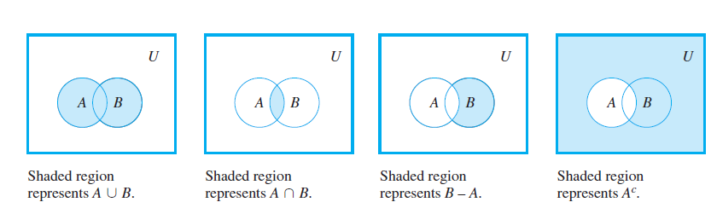
Concept

Slide 44
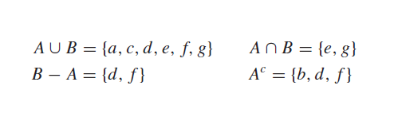
Example

Slide 45
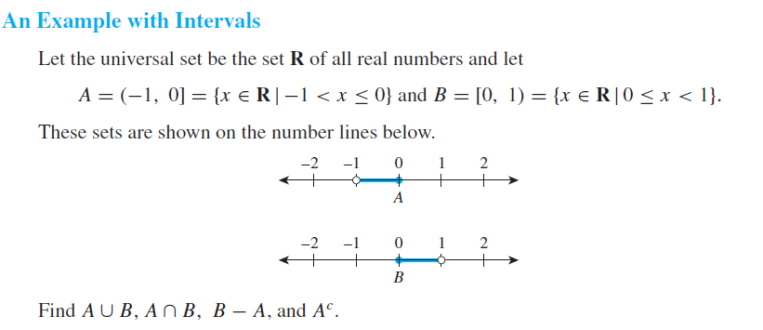
Example

Slide 46
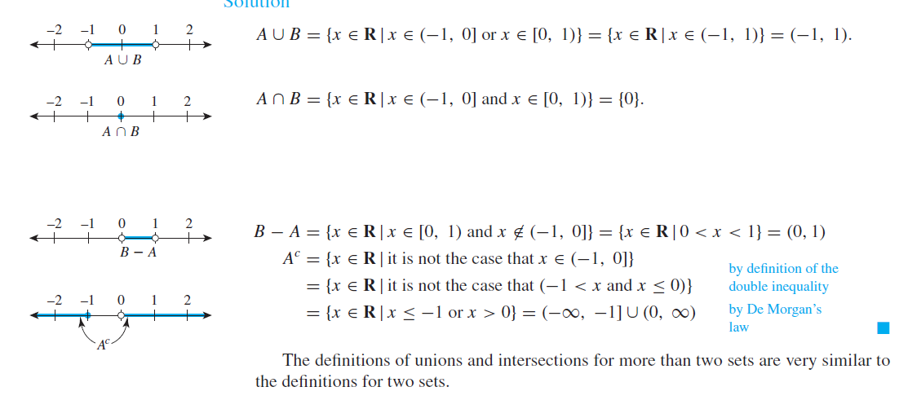
Answer

Slide 47
Review Questions
Example: U = {0,1,2,3,4,5,6,7,8,9,10} A = {1,2,3,4,5}, B ={4,5,6,7,8}
A ∪ B
A ∩ B
Ā
A – B
B – A

Slide 48
Review Questions
Example: U = {0,1,2,3,4,5,6,7,8,9,10} A = {1,2,3,4,5}, B ={4,5,6,7,8}
A ∪ B
Solution: {1,2,3,4,5,6,7,8}
A ∩ B
Solution: {4,5}
Ā
Solution: {0,6,7,8,9,10}
Solution: {0,1,2,3,9,10}
A – B
Solution: {1,2,3}
B – A
Solution: {6,7,8}

Slide 49



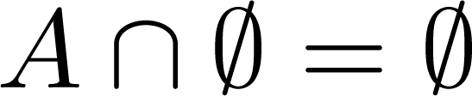


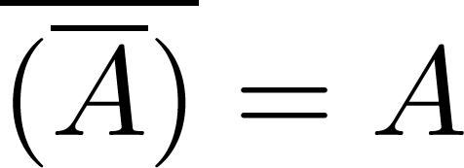
Set Identities
Identity laws
Domination laws
Idempotent laws
Complementation law
Continued on next slide →

Slide 50


Set Identities
Commutative laws
Associative laws
Distributive laws
Continued on next slide →

Slide 51


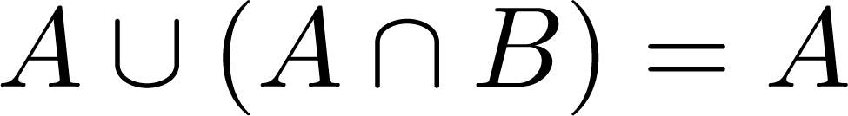
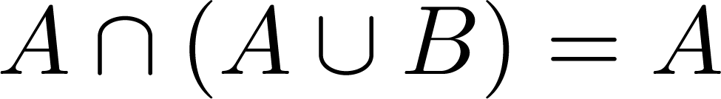

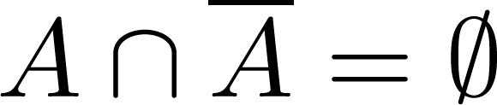
Set Identities
De Morgan’s laws
Absorption laws
Complement laws

Slide 52
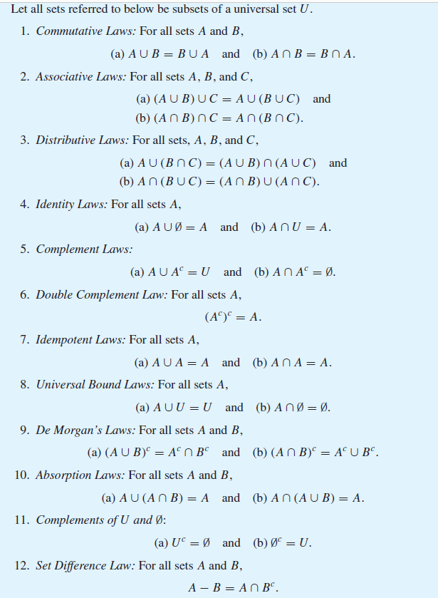

Slide 53
Proving Set Identities
Different ways to prove set identities:
Prove that each set (side of the identity) is a subset of the other.
Use set builder notation and propositional logic.
Membership Tables: Verify that elements in the same combination of sets always either belong or do not belong to the same side of the identity. Use 1 to indicate it is in the set and a 0 to indicate that it is not.

Slide 54
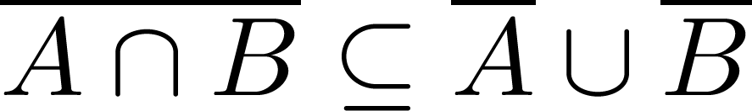

Proof of Second De Morgan Law
Example: Prove that
Solution: We prove this identity by showing that:
1) and
2)
Continued on next slide →

Slide 55
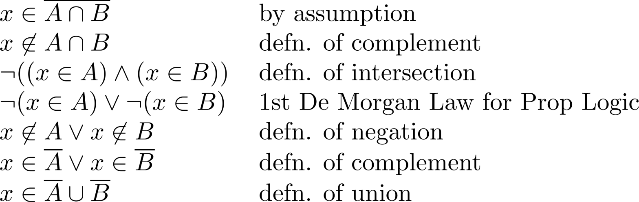
Proof of Second De Morgan Law
These steps show that:
Continued on next slide →

Slide 56
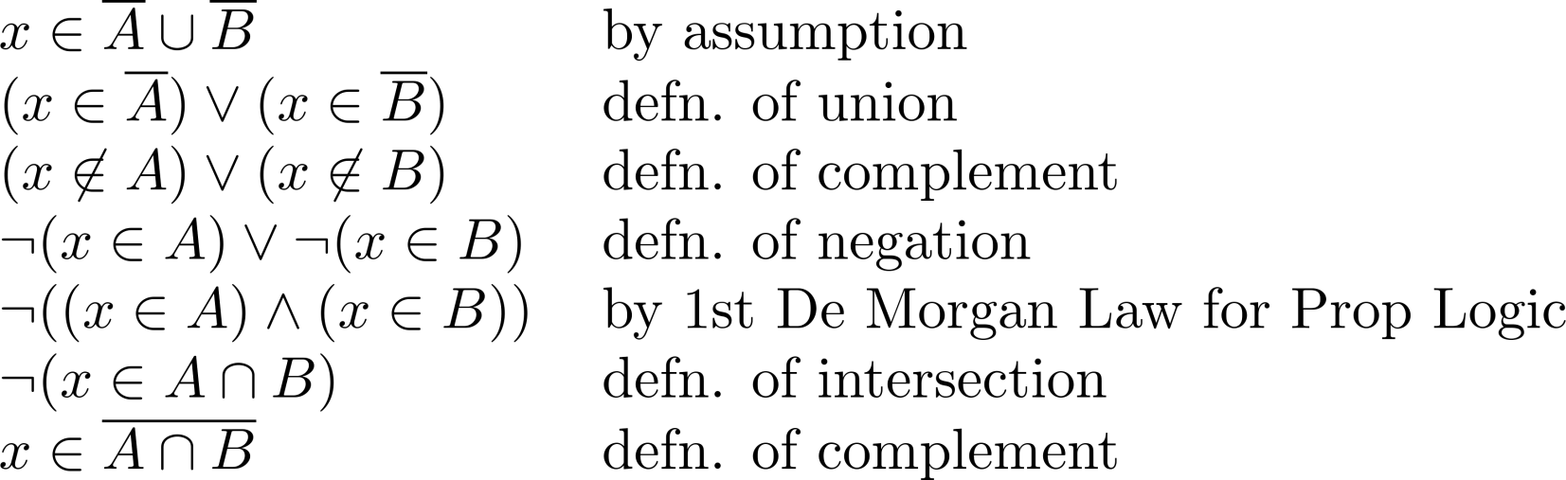
Proof of Second De Morgan Law
These steps show that:

Slide 57
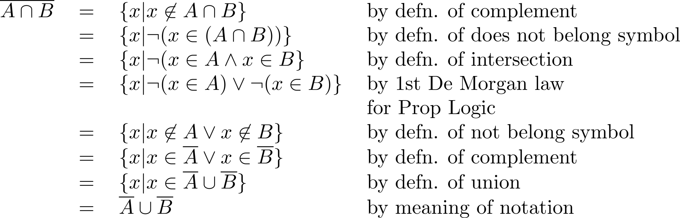
Set-Builder Notation: Second De Morgan Law

Slide 58
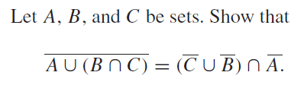
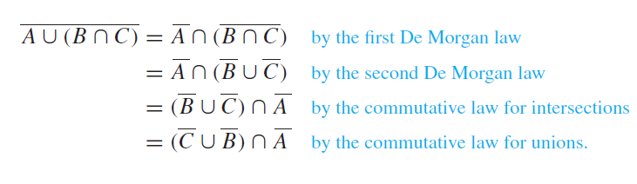
Example

Slide 59





Membership Table
Example:
Construct a membership table to show that the distributive law holds.
Solution:
A | B | C
1 | 1 | 1 | 1 | 1 | 1 | 1 | 1
1 | 1 | 0 | 0 | 1 | 1 | 1 | 1
1 | 0 | 1 | 0 | 1 | 1 | 1 | 1
1 | 0 | 0 | 0 | 1 | 1 | 1 | 1
0 | 1 | 1 | 1 | 1 | 1 | 1 | 1
0 | 1 | 0 | 0 | 0 | 1 | 0 | 0
0 | 0 | 1 | 0 | 0 | 0 | 1 | 0
0 | 0 | 0 | 0 | 0 | 0 | 0 | 0

Slide 60
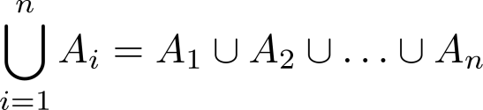
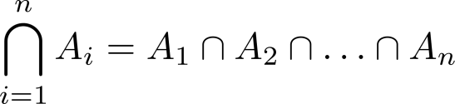
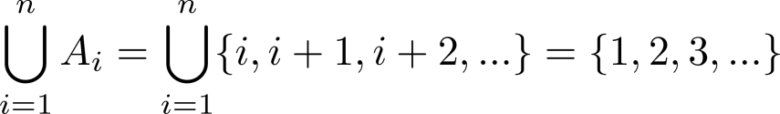
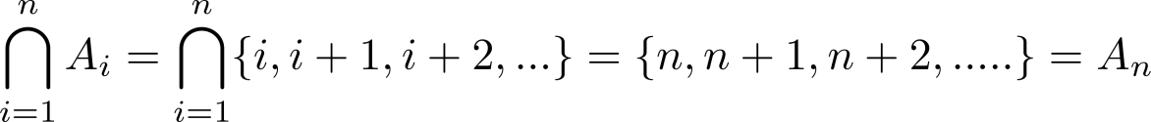
Generalized Unions and Intersections
Let A₁, A₂ ,…, A_{n} be an indexed collection of sets.
We define:
These are well defined, since union and intersection are associative.
For i = 1,2,…, let A_{i} = {i, i + 1, i + 2, ….}. Then,

Slide 61
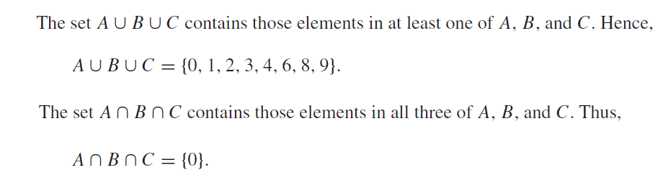
Example

Slide 62
Computer Representation of Sets
Assume the universal set U is finite (not larger than the memory size of the computer being used)
First specify an arbitrary ordering of the elements in U, for instance a1, a2,…, an
Represent a subset A of U with the bit string of length n, where the ith bit is 1 if ai belongs to A and is 0 if ai does not belong to A
Example: Let U ={1, 2, 3, 4, 5, 6, 7, 8, 9, 10}, and the ordering of U has the elements in the increasing order.
What bit strings represent the subset of all odd integers?
What bit string represents the set of all even integers?
What bit string represents the subset of integers not exceeding 5 in U?
What is the bit string that represents the complement of a subset?
What is the bit string that represents the union of two subsets?
What is the bit string that represents the intersection of two subsets?

Slide 63
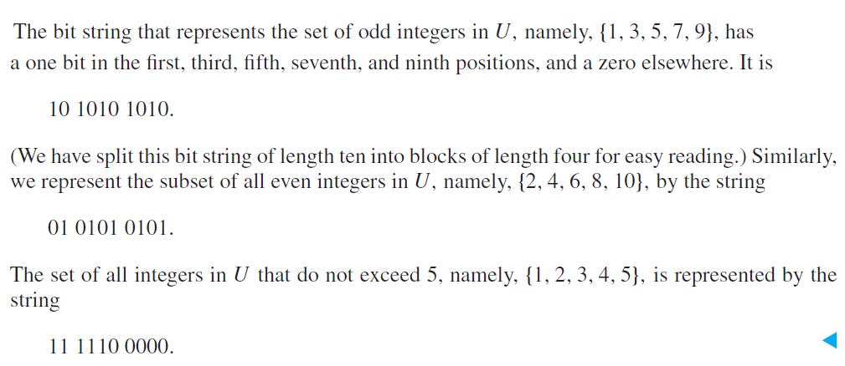
Solution

Slide 64
Functions
Section 2.3

Slide 65
Section Summary
Definition of a Function.
Domain, Codomain
Image, Preimage
Injection, Surjection, Bijection
Inverse Function
Function Composition
Graphing Functions
Floor, Ceiling, Factorial

Slide 66
Functions and Sets
A function f from a set X to a set Y, denoted f : X → Y , is a relation from X, the domain, to Y , the co-domain, that satisfies two properties: (1) every element in X is related to some element in Y , and (2) no element in X is related to more than one element in Y .
“ f maps x to y” and write x →y or f : x → y. The unique element to which f sends x is denoted

Slide 67
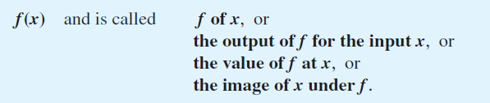

Functions and Sets

Slide 68


Arrow Diagrams
If X and Y are finite sets, you can define a function f from X to Y by drawing an arrow diagram. You make a list of elements in X and a list of elements in Y , and draw an arrow from each element in X to the corresponding element in Y.

Slide 69


Example

Slide 70


Example

Slide 71


Test for Function Equality

Slide 72

Equality of Functions

Slide 73


Solution

Slide 74



Functions Defined on a Cartesian Product

Slide 75



Boolean Functions

Slide 76


Example

Slide 77


Functions Acting on Sets

Slide 78
Functions
Definition: Let A and B be nonempty sets. A function f from A to B, denoted f: A → B is an assignment of each element of A to exactly one element of B. We write f(a) = b if b is the unique element of B assigned by the function f to the element a of A.
Functions are sometimes
called mappings or
transformations.
Students
Grades
A
Carlota Rodriguez
B
Sandeep Patel
C
Jalen Williams
D
F
Kathy Scott

Slide 79
Functions
A function f: A → B can also be defined as a subset of A×B (a relation). This subset is restricted to be a relation where no two elements of the relation have the same first element.
Specifically, a function f from A to B contains one, and only one ordered pair (a, b) for every element a∈ A.
and

Slide 80

Functions
Given a function f: A → B:
We say f maps A to B or
f is a mapping from A to B.
A is called the domain of f.
B is called the codomain of f.
If f(a) = b,
then b is called the image of a under f.
a is called the preimage of b.
The range of f is the set of all images of points in A under f. We denote it by f(A).
Two functions are equal when they have the same domain, the same codomain and map each element of the domain to the same element of the codomain.

Slide 81
Representing Functions
Functions may be specified in different ways:
An explicit statement of the assignment.
Students and grades example.
A formula.
f(x) = x + 1
A computer program.
A Java program that when given an integer n, produces the nth Fibonacci Number (covered in the next section and also in Chapter 5).

Slide 82
Questions
A
B
f(a) = ?
The image of d is ?
a
x
The domain of f is ?
b
y
The codomain of f is ?
c
d
z
The preimage of y is ?
f(A) = ?
The preimage(s) of z is (are) ?

Slide 83
Questions
z
A
B
f(a) = ?
The image of d is ?
z
a
x
The domain of f is ?
A
b
y
The codomain of f is ?
B
c
d
z
The preimage of y is ?
b
f(A) = ? {y, z}
The preimage(s) of z is (are) ?
{a,c,d}

Slide 84


Question on Functions and Sets
If and S is a subset of A, then
A
B
f {a,b,c,} is ?
a
x
f {c,d} is ?
b
y
c
d
z

Slide 85
Question on Functions and Sets
If and S is a subset of A, then
A
B
f {a,b,c,} is ?
{y,z}
a
x
f {c,d} is ?
b
{z}
y
c
d
z

Slide 86


One-to-One Functions

Slide 87

Graphical Illustration

Slide 88

Identifying One-to-One Functions Defined on Finite Sets

Slide 89


Solution

Slide 90

Proving or Disproving That Functions Are One-to-One

Slide 91


Solution

Slide 92


Onto Functions

Slide 93

Graphical Illustration

Slide 94


Identifying Onto Functions Defined on Finite Sets

Slide 95

Solution

Slide 96

Proving or Disproving That Functions Are Onto

Slide 97

Solution

Slide 98

Solution

Slide 99

One-to-One Correspondences

Slide 100

Example: A Function of Two Variables

Slide 101


Proof

Slide 102

Proof

Slide 103


Inverse Functions

Slide 104

Finding an Inverse Function for a Function Given by an Arrow Diagram

Slide 105


Example

Slide 106

Proof

Slide 107

Finding an Inverse Function for a Function of Two Variables

Slide 108


Composition of Functions

Slide 109

Schematic Representation

Slide 110


Problem

Slide 111

Solution

Slide 112

Composition of Functions Defined on Finite Sets

Slide 113

Solution

Slide 114



Composition with the Identity Function

Slide 115


Solution

Slide 116



Composition with an Identity Function

Slide 117


Composing a Function with Its Inverse

Slide 118

Composing a Function with Its Inverse

Slide 119



Composition of a Function with Its Inverse

Slide 120

Proof

Slide 121


Composition of One-to-One Functions

Slide 122

Proof

Slide 123


Composition of Onto Functions

Slide 124


Proof

Slide 125



Graphical Illustration

Slide 126



Cardinality with Applications

Slide 127

Definition

Slide 128

Countable Sets
We will now split infinite sets into two groups, those with the same cardinality as the set of natural numbers and those with a different cardinality.
A set that is either finite or has the same cardinality as the set of positive integers is called countable. A set that is not countable is called uncountable

Slide 129

Show that the set of odd positive integers is a countable set.

Slide 130

Show that the set of all integers is countable.

Slide 131


Let 2Z be the set of all even integers. Prove that 2Z and Z have the same cardinality.

Slide 132

Solution

Slide 133


Countable Sets

Slide 134


Show that the set Z of all integers is countable.

Slide 135



The Search for Larger Infinities: The Cantor Diagonalization Process
The Set of All Positive Rational Numbers Is Countable

Slide 136


Show that the set of all real numbers has the same cardinality as the set of real numbers between 0 and 1.

Slide 137
Injections
Definition: A function f is said to be one-to-one , or injective, if and only if f(a) = f(b) implies that a = b for all a and b in the domain of f. A function is said to be an injection if it is one-to-one.
A
B
a
x
v
b
y
c
z
d
w

Slide 138



Surjections
Definition: A function f from A to B is called onto or surjective, if and only if for every element there is an element with . A function f is called a surjection if it is onto.
A
B
a
x
b
y
c
z
d

Slide 139
Bijections
Definition: A function f is a one-to-one correspondence, or a bijection, if it is both one-to-one and onto (surjective and injective).
A
B
a
x
b
y
c
d
z
w

Slide 140

Examples of Different Types of Correspondences.

Slide 141

Showing that f is one-to-one or onto

Slide 142
Showing that f is one-to-one or onto
Example 1: Let f be the function from {a,b,c,d} to {1,2,3} defined by f(a) = 3, f(b) = 2, f(c) = 1, and f(d) = 3. Is f an onto function?
Example 2: Is the function f(x) = x² from the set of integers onto?

Slide 143
Showing that f is one-to-one or onto
Example 1: Let f be the function from {a,b,c,d} to {1,2,3} defined by f(a) = 3, f(b) = 2, f(c) = 1, and f(d) = 3. Is f an onto function?
Solution: Yes, f is onto since all three elements of the codomain are images of elements in the domain. If the codomain were changed to {1,2,3,4}, f would not be onto.
Example 2: Is the function f(x) = x² from the set of integers onto?
Solution: No, f is not onto because there is no integer x with x² = −1, for example.

Slide 144



Inverse Functions
Definition: Let f be a bijection from A to B. Then the inverse of f, denoted , is the function from B to A defined as
No inverse exists unless f is a bijection. Why?

Slide 145
Inverse Functions
A
B
A
B
f
a
V
V
a
b
b
W
W
c
c
d
X
X
d
Y
Y

Slide 146
Questions
Example 1: Let f be the function from {a,b,c} to {1,2,3} such that f(a) = 2, f(b) = 3, and f(c) = 1. Is f invertible and if so what is its inverse?

Slide 147
Questions
Example 1: Let f be the function from {a,b,c} to {1,2,3} such that f(a) = 2, f(b) = 3, and f(c) = 1. Is f invertible and if so what is its inverse?
Solution: The function f is invertible because it is a one-to-one correspondence. The inverse function f⁻¹ reverses the correspondence given by f, so f⁻¹ (1) = c, f⁻¹ (2) = a, and f⁻¹ (3) = b.

Slide 148
Questions
Example 2: Let f: Z → Z be such that f(x) = x + 1. Is f invertible, and if so, what is its inverse?

Slide 149
Questions
Example 2: Let f: Z → Z be such that f(x) = x + 1. Is f invertible, and if so, what is its inverse?
Solution: The function f is invertible because it is a one-to-one correspondence. The inverse function f⁻¹ reverses the correspondence so f⁻¹ (y) = y – 1.

Slide 150

Questions
Example 3: Let f: R → R be such that . Is f invertible, and if so, what is its inverse?

Slide 151
Questions
Example 3: Let f: R → R be such that . Is f invertible, and if so, what is its inverse?
Solution: The function f is not invertible because it is not one-to-one .

Slide 152



Composition
Definition: Let f: B → C, g: A → B. The composition of f with g, denoted is the function from A to C defined by

Slide 153
Composition
A
g
B
f
C
A
C
V
a
a
h
h
b
i
b
W
i
c
c
X
j
d
d
j
Y

Slide 154



Composition
Example 1: If and , then
and

Slide 155
Composition Questions
Example 2: Let g be the function from the set {a,b,c} to itself such that g(a) = b, g(b) = c, and g(c) = a. Let f be the function from the set {a,b,c} to the set {1,2,3} such that f(a) = 3, f(b) = 2, and f(c) = 1.
What is the composition of f and g, and what is the composition of g and f.

Slide 156
Composition Questions
Example 2: Let g be the function from the set {a,b,c} to itself such that g(a) = b, g(b) = c, and g(c) = a. Let f be the function from the set {a,b,c} to the set {1,2,3} such that f(a) = 3, f(b) = 2, and f(c) = 1.
What is the composition of f and g, and what is the composition of g and f.
Solution: The composition f∘g is defined by
f∘g (a)= f(g(a)) = f(b) = 2.
f∘g (b)= f(g(b)) = f(c) = 1.
f∘g (c)= f(g(c)) = f(a) = 3.
Note that g∘f is not defined, because the range of f is not a subset of the domain of g.

Slide 157
Composition Questions
Example 2: Let f and g be functions from the set of integers to the set of integers defined by f(x) = 2x + 3 and g(x) = 3x + 2.
What is the composition of f and g, and also the composition of g and f ?

Slide 158
Composition Questions
Example 2: Let f and g be functions from the set of integers to the set of integers defined by f(x) = 2x + 3 and g(x) = 3x + 2.
What is the composition of f and g, and also the composition of g and f ?
Solution:
f∘g (x)= f(g(x)) = f(3x + 2) = 2(3x + 2) + 3 = 6x + 7
g∘f (x)= g(f(x)) = g(2x + 3) = 3(2x + 3) + 2 = 6x + 11

Slide 159


Graphs of Functions
Let f be a function from the set A to the set B. The graph of the function f is the set of ordered pairs {(a,b) | a ∈A and f(a) = b}.
Graph of f(n) = 2n + 1
from Z to Z
Graph of f(x) = x²
from Z to Z

Slide 160






Some Important Functions
The floor function, denoted
is the largest integer less than or equal to x.
The ceiling function, denoted
is the smallest integer greater than or equal to x
Example:

Slide 161

Floor and Ceiling Functions
Graph of (a) Floor and (b) Ceiling Functions

Slide 162

Floor and Ceiling Functions

Slide 163
Computer Applications of Floor and Ceiling Functions
Example: Data stored on a computer or transmitted over a network are represented as a string of bytes. Each byte consists of 8 bits. How many bytes are required to encode 100 bits of data?
Example: In asynchronous transfer mode (ATM)
(a communication protocol used in backbone networks), data are organized into cells of 53 bytes. How many ATM cells can be transmitted in 1 minute over a connection that transmits data at a rate of 500 kilobits per second?
Notes:
A1: ceiling of 100/8 = 13; A2: floor of (60 x 500.0000)/ (53 x 8) = floor of 30.000.000/424 = 70.754

Slide 164
Proving Properties of Functions
Example: Prove that x is a real number, then
⌊2x⌋= ⌊x⌋ + ⌊x + ½⌋

Slide 165
Proving Properties of Functions
Example: Prove that x is a real number, then
⌊2x⌋= ⌊x⌋ + ⌊x + 1/2⌋
Solution: Let x = n + ε, where n is an integer and 0 ≤ ε< 1.
Case 1: ε < ½
2x = 2n + 2ε and ⌊2x⌋ = 2n, since 0 ≤ 2ε< 1.
⌊x + 1/2⌋ = n, since x + ½ = n + (1/2 + ε ) and 0 ≤ ½ +ε < 1.
Hence, ⌊2x⌋ = 2n and ⌊x⌋ + ⌊x + 1/2⌋ = n + n = 2n.
Case 2: ε ≥ ½
2x = 2n + 2ε = (2n + 1) +(2ε − 1) and ⌊2x⌋ =2n + 1, since 0 ≤ 2 ε - 1< 1.
⌊x + 1/2⌋ = ⌊ n + (1/2 + ε)⌋ = ⌊ n + 1 + (ε – 1/2)⌋ = n + 1 since 0 ≤ ε – 1/2< 1.
Hence, ⌊2x⌋ = 2n + 1 and ⌊x⌋ + ⌊x + 1/2⌋ = n + (n + 1) = 2n + 1.

Slide 166

Factorial Function
Definition: f: N → Z⁺ , denoted by f(n) = n! is the product of the first n positive integers when n is a nonnegative integer.
f(n) = 1 ∙ 2 ∙∙∙ (n – 1) ∙ n, f(0) = 0! = 1
Examples:
^{f(1) = 1! = 1}
^{f(2) = 2! = 1 ∙ 2 = 2}
^{f(6) = 6! = 1 ∙ 2 ∙ 3∙ 4∙ 5} ^{∙ 6 = 720}
f(20) = 2,432,902,008,176,640,000.
Stirling’s Formula:

Slide 167
Sequences and Summations
Section 2.4

Slide 168
Section Summary
Sequences.
Examples: Geometric Progression, Arithmetic Progression
Recurrence Relations
Example: Fibonacci Sequence
Summations

Slide 169
Introduction
Sequences are ordered lists of elements.
1, 2, 3, 5, 8
1, 3, 9, 27, 81, …….
Sequences arise throughout mathematics, computer science, and in many other disciplines, ranging from botany to music.
We will introduce the terminology to represent sequences and sums of the terms in the sequences.

Slide 170

Introduction
Imagine that a person decides to count his ancestors. He has two parents, four grandparents, eight great-grandparents, and so forth, These numbers can be written in a row as
2, 4, 8, 16, 32, 64, 128, . . .
To express the pattern of the numbers, suppose that each is labeled by an integer giving its position in the row.

Slide 171
Sequences
Definition: A sequence is a function from a subset of the integers (usually either the set {0, 1, 2, 3, 4, …..} or {1, 2, 3, 4, ….} ) to a set S.
The notation a_{n} is used to denote the image of the integer n. We can think of a_{n} as the equivalent of f(n) where f is a function from {0,1,2,…..} to S. We call a_{n} a term of the sequence.

Slide 172



Sequences
Example: Consider the sequence where

Slide 173

Geometric Progression
Definition: A geometric progression is a sequence of the form:
where the initial term a and the common ratio r are real numbers.
Examples:
Let a = 1 and r = −1. Then:
Let a = 2 and r = 5. Then:
Let a = 6 and r = 1/3. Then:
Notes:
For any ratio, any three consecutive terms a, b, c will satisfy b^2 = ac, i.e., b is the geometric mean of a and c

Slide 174
Arithmetic Progression
Definition: A arithmetic progression is a sequence of the form:
where the initial term a and the common difference d are real numbers.
Examples:
Let a = −1 and d = 4:
Let a = 7 and d = −3:
Let a = 1 and d = 2:
Notes:
For any difference, any three consecutive terms a, b, c will satisfy b = (a + c) /2, i.e. b is the arithmetic mean of a and c

Slide 175

Finding Terms of Sequences Given by Explicit Formulas

Slide 176




Finding an Explicit Formula to Fit Given Initial Terms

Slide 177

Summation Notation
Consider again the example in which A_{k} = 2^{k} represents the number of ancestors a person has in the kth generation back. What is the total number of ancestors for the past six generations?

Slide 178


Changing from Summation Notation to Expanded Form

Slide 179


Changing from Expanded Form to Summation Notation

Slide 180
Sequences Used in Computer Science: Strings
Definition: A string is a finite sequence of characters from a finite set (an alphabet).
Sequences of characters or bits are important in computer science.
The empty string is represented by λ.
The string abcde has length 5.
The (bit) string 0011 1100 has length 8.

Slide 181
Recurrence Relations
Definition: A recurrence relation for the sequence {a_{n}} is an equation that expresses a_{n} in terms of one or more of the previous terms of the sequence, namely, a₀, a₁, …, a_{n-1}, for all integers n with n ≥ n₀, where n₀ is a nonnegative integer.
A sequence is called a solution of a recurrence relation if its terms satisfy the recurrence relation.
The initial conditions for a sequence specify the terms that precede the first term where the recurrence relation takes effect.

Slide 182
Questions about Recurrence Relations
Example 1: Let {a_{n}} be a sequence that satisfies the recurrence relation a_{n} = a_{n-1} + 3 for n = 1,2,3,4,…. and suppose that a₀ = 2. What are a₁ , a₂ and a₃?
[Here a₀ = 2 is the initial condition.]
Solution: We see from the recurrence relation that
a₁ = a₀ + 3 = 2 + 3 = 5
a₂ = 5 + 3 = 8
a₃ = 8 + 3 = 11

Slide 183
Questions about Recurrence Relations
Example 2: Let {a_{n}} be a sequence that satisfies the recurrence relation a_{n} = a_{n-1} – a_{n-2} for n = 2,3,4,…. and suppose that a₀ = 3 and a₁ = 5. What are a₂ and a₃?
[Here the initial conditions are a₀ = 3 and a₁ = 5. ]

Slide 184
Questions about Recurrence Relations
Example 2: Let {a_{n}} be a sequence that satisfies the recurrence relation a_{n} = a_{n-1} – a_{n-2} for n = 2,3,4,…. and suppose that a₀ = 3 and a₁ = 5. What are a₂ and a₃?
[Here the initial conditions are a₀ = 3 and a₁ = 5. ]
Solution: We see from the recurrence relation that
a₂ = a₁ - a₀ = 5 – 3 = 2
a₃ = a₂ – a₁ = 2 – 5 = –3

Slide 185
Fibonacci Sequence
Definition: Define the Fibonacci sequence, f₀ ,f₁ ,f₂,…, by:
Initial Conditions: f₀ = 0, f₁ = 1
Recurrence Relation: f_{n} = f_{n-1} + f_{n-2}
Example: Find f₂ ,f₃ ,f₄ , f₅ and f₆ .

Slide 186
Fibonacci Sequence
Definition: Define the Fibonacci sequence, f₀ ,f₁ ,f₂,…, by:
Initial Conditions: f₀ = 0, f₁ = 1
Recurrence Relation: f_{n} = f_{n-1} + f_{n-2}
Example: Find f₂ ,f₃ ,f₄ , f₅ and f₆ .
Answer:
f₂ = f₁ + f₀ = 1 + 0 = 1,
f₃ = f₂ + f₁ = 1 + 1 = 2,
f₄ = f₃ + f₂ = 2 + 1 = 3,
f₅ = f₄ + f₃ = 3 + 2 = 5,
f₆ = f₅ + f₄ = 5 + 3 = 8.

Slide 187


Fibonacci Sequence and the Golden Ratio
Golden Ratio : (a+b)/a = a/b = φ
Solution φ = (1+ √5)/2 = 1.61...
lim n→∞ (f n+1 /f n) = φ

Slide 188

Golden Ratio in Nature

Slide 189



Golden Ratio in Nature

Slide 190

Golden Ratio in Art

Slide 191

Golden Ratio in Architecture

Slide 192
Solving Recurrence Relations
Finding a formula for the nth term of the sequence generated by a recurrence relation is called solving the recurrence relation.
Such a formula is called a closed formula.
Various methods for solving recurrence relations are covered in Chapter 8 where recurrence relations are studied in greater depth.
Here we illustrate by example the method of iteration in which we need to guess the formula. The guess can be proved correct by the method of induction (Chapter 5).

Slide 193
Iterative Solution Example
Method 1: Working upward, forward substitution
Let {a_{n}} be a sequence that satisfies the recurrence relation a_{n} = a_{n-1} + 3 for n = 2,3,4,…. and suppose that a₁ = 2.
a₂ = 2 + 3
a₃ = (2 + 3) + 3 = 2 + 3 ∙ 2
a₄ = (2 + 2 ∙ 3) + 3 = 2 + 3 ∙ 3
.
.
.
a_{n} = a_{n-1} + 3 = (2 + 3 ∙ (n – 2)) + 3 = 2 + 3(n – 1)

Slide 194
Iterative Solution Example
Method 2: Working downward, backward substitution
Let {a_{n}} be a sequence that satisfies the recurrence relation a_{n} = a_{n-1} + 3 for n = 2,3,4,…. and suppose that a₁ = 2.
a_{n} = a_{n-1} + 3
= (a_{n-2} + 3) + 3 = a_{n-2} + 3 ∙ 2
= (a_{n-3} + 3 )+ 3 ∙ 2 = a_{n-3} + 3 ∙ 3
.
.
.
= a₂ + 3(n – 2) = (a₁ + 3) + 3(n – 2) = 2 + 3(n – 1)

Slide 195
Financial Application
Example: Suppose that a person deposits $10,000.00 in a savings account at a bank yielding 11% per year with interest compounded annually. How much will be in the account after 30 years?
Let P_{n} denote the amount in the account after n years. P_{n} satisfies the following recurrence relation:
P_{n} = P_{n-1} + 0.11P_{n-1} = (1.11) P_{n-1}
with the initial condition P₀ = 10,000
Continued on next slide →

Slide 196
Financial Application
P_{n} = P_{n-1} + 0.11P_{n-1} = (1.11) P_{n-1}
with the initial condition P₀ = 10,000
Solution: Forward Substitution
P₁ = (1.11)P₀
P₂ = (1.11)P₁ = (1.11)²P₀
P₃ = (1.11)P₂ = (1.11)³P₀
:
P_{n} = (1.11)P_{n-1} = (1.11)^{n}P₀ = (1.11)^{n} 10,000
P_{n} = (1.11)^{n} 10,000 (Can prove by induction, covered in Chapter 5)
P₃₀ = (1.11)³⁰ 10,000 = $228,992.97

Slide 197

Useful Sequences

Slide 198




Summations
Sum of the terms
from the sequence
The notation:
represents
The variable j is called the index of summation. It runs through all the integers starting with its lower limit m and ending with its upper limit n.

Slide 199




Summations
More generally for a set S:
Examples:

Slide 200



Product Notation
Product of the terms
from the sequence
The notation:
represents

Slide 201


Product Notation

Slide 202

Geometric Series
Sums of terms of geometric progressions
Continued on next slide →

Slide 203



Geometric Series
Sums of terms of geometric progressions
To compute S_{n} , first multiply both sides of the equality by r and then manipulate the resulting sum as follows:
Proof:
Let
Continued on next slide →

Slide 204






Geometric Series
From previous slide.
Shifting the index of summation with k = j + 1.
Removing k = n + 1 term and
adding k = 0 term.
Substituting S for summation formula
∴
if r ≠1
if r = 1

Slide 205

Some Useful Summation Formulae
Geometric Series: We just proved this.
Later we will prove some of these by induction.
Proof in text
(requires calculus)

Slide 206
Matrices
Section 2.6

Slide 207
Section Summary
Definition of a Matrix
Matrix Arithmetic
Transposes and Powers
Zero-One Matrices

Slide 208
Matrices
Matrices are useful discrete structures that can be used in many ways. For example, they are used to:
describe certain types of functions known as linear transformations.
Express which vertices of a graph are connected by edges (see Chapter 10).
In later chapters, we will see matrices used to build models of:
Transportation systems.
Communication networks.
Algorithms based on matrix models will be presented in later chapters.
Here we cover the aspect of matrix arithmetic that will be needed later.

Slide 209


Matrix
Definition: A matrix is a rectangular array of numbers. A matrix with m rows and n columns is called an m n matrix.
The plural of matrix is matrices.
A matrix with the same number of rows as columns is called square.
Two matrices are equal if they have the same number of rows and the same number of columns and the corresponding entries in every position are equal.
3 2 matrix

Slide 210


Notation
Let m and n be positive integers and let
The ith row of A is the 1 n matrix [a_{i1}, a_{i2},…,a_{in}]. The jth column of A is the m 1 matrix:
The (i,j)th element or entry of A is the
element a_{ij}. We can use A = [a_{ij} ] to denote the matrix with its (i,j)th element equal to a_{ij}.

Slide 211

Matrix Arithmetic: Addition
Defintion: Let A = [a_{ij}] and B = [b_{ij}] be m n matrices. The sum of A and B, denoted by A + B, is the m n matrix that has a_{ij} + b_{ij} as its (i,j)th element. In other words, A + B = [a_{ij} + b_{ij}].
Example:
Note that matrices of different sizes can not be added.

Slide 212

Matrix Multiplication
Definition: Let A be an n k matrix and B be a k n matrix. The product of A and B, denoted by AB, is the m n matrix that has its (i,j)th element equal to the sum of the products of the corresponding elements from the ith row of A and the jth column of B. In other words, if AB = [c_{ij}] then c_{ij} = a_{i1}b_{1j} + a_{i2}b_{2j} + … + ai_{k}b_{kj}.
Example:
The product of two matrices is undefined when the number of columns in the first matrix is not the same as the number of rows in the second.

Slide 213



Illustration of Matrix Multiplication
The Product of A = [a_{ij}] and B = [b_{ij}]

Slide 214




Matrix Multiplication is not Commutative
Example: Let
Does AB = BA?
Solution:
AB ≠ BA

Slide 215

Identity Matrix and Powers of Matrices
Definition: The identity matrix of order n is the m n matrix I_{n} = [δ_{ij}], where δ_{ij} = 1 if i = j and δ_{ij} = 0 if i≠j.
AI_{n} = I_{m}A = A
when A is an m n matrix
Powers of square matrices can be defined. When A is an n × n matrix, we have:
A⁰ = I_{n} A^{r} = AAA∙∙∙A
r times

Slide 216

Transposes of Matrices
Definition: Let A = [a_{ij}] be an m n matrix. The transpose of A, denoted by A^{t} ,is the n m matrix obtained by interchanging the rows and columns of A.
If A^{t} = [b_{ij}], then b_{ij} = a_{ji} for i =1,2,…,n and j = 1,2, ...,m.

Slide 217

Transposes of Matrices
Definition: A square matrix A is called symmetric if A = A^{t}. Thus A = [a_{ij}] is symmetric if a_{ij} = a_{ji} for i and j with 1≤ i≤ n and 1≤ j≤ n.
Square matrices do not change when their rows and columns are interchanged.

Slide 218


Zero-One Matrices
Definition: A matrix all of whose entries are either 0 or 1 is called a zero-one matrix. (These will be used in Chapters 9 and 10.)
Algorithms operating on discrete structures represented by zero-one matrices are based on Boolean arithmetic defined by the following Boolean operations:

Slide 219
Zero-One Matrices
Definition: Let A = [a_{ij}] and B = [b_{ij}] be an m × n zero-one matrices.
The join of A and B is the zero-one matrix with (i,j)th entry a_{ij} ∨ b_{ij}. The join of A and B is denoted by A ∨ B.
The meet of of A and B is the zero-one matrix with (i,j)th entry a_{ij} ∧ b_{ij}. The meet of A and B is denoted by A ∧ B.

Slide 220


Joins and Meets of Zero-One Matrices
Example: Find the join and meet of the zero-one matrices

Slide 221


Joins and Meets of Zero-One Matrices
Example: Find the join and meet of the zero-one matrices
Solution: The join of A and B is
The meet of A and B is

Slide 222


Boolean Product of Zero-One Matrices
Definition: Let A = [a_{ij}] be an m k zero-one matrix and B = [b_{ij}] be a k n zero-one matrix. The Boolean product of A and B, denoted by A ⊙ B, is the m n zero-one matrix with(i,j)th entry
c_{ij} = (a_{i1} ∧ b_{1j})∨ (a_{i2} ∧ b_{2j}) ∨ … ∨ (a_{ik} ∧ b_{kj}).
Example: Find the Boolean product of A and B, where
Continued on next slide →

Slide 223



Boolean Product of Zero-One Matrices
Solution: The Boolean product A ⊙ B is given by

Slide 224

Boolean Powers of Zero-One Matrices
Definition: Let A be a square zero-one matrix and let r be a positive integer. The rth Boolean power of A is the Boolean product of r factors of A, denoted by A^{[r]} . Hence,
We define A^{[r]} to be I_{n}.
(The Boolean product is well defined because the Boolean product of matrices is associative.)

Slide 225





Boolean Powers of Zero-One Matrices
Example: Let
Find A^{n} for all positive integers n.
Solution:

